Slide 1

Smart Shoe for Wireless Ground Reaction Force Monitoring using
Differential Pressure Sensors
Dhruv Shambhu Thakkar
(Research Intern, HCR Lab, IIT Gandhinagar)
Indian Institute of Technology Gandhinagar

Slide 2
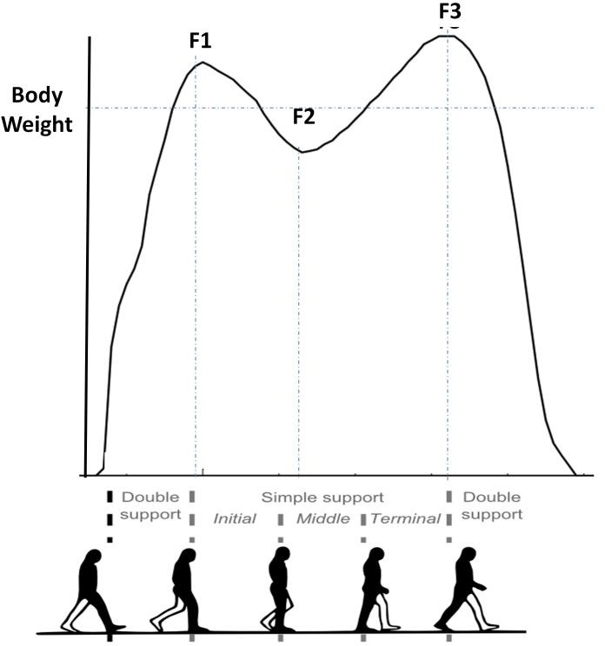
Introduction
What is Ground Reaction Force?
GRF is the force exerted by the ground on a body in contact with it.
Why do we need to monitor GRF ?
Insights into biomechanics of Human Movement
(Gait Analysis, Balance Control, Force/Load Distribution)
Assessment & Identification of abnormalities & asymmetries ( joint loadings, altered force patterns etc)
Injury Prevention, Performance Optimization, Rehabilitation
Assistive Device Design Improvement
[1]
[1] Bonnefoy-Mazure, A. & Armand, Stéphane. (2015). Normal gait.

Slide 3
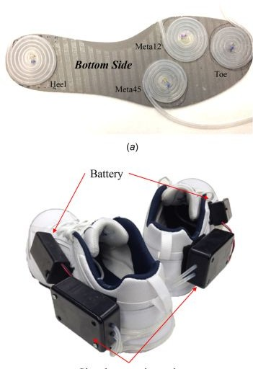
Literature Review
1. A Wireless Human Motion Monitoring System for Smart Rehabilitation:
The study introduces a wireless human motion monitoring system designed for gait analysis and visual feedback in rehabilitation training.
The system incorporates inertial sensors and smart shoes with pressure sensors to capture lower-extremity joint rotations and measure force distributions during walking.
The raw measurement data is used to calculate gait phases, step lengths, and center of pressure (CoP) to assess abnormal walking behaviors.
User interfaces were developed & results demonstrated that patients could comprehend the visual feedback and achieved comparable training performance to traditional gait training with physical therapists.
Overall, the research paper presents a promising wireless monitoring system that enables effective gait analysis and rehabilitation training.
[2]
[2] Zhang, Wenlong, Masayoshi Tomizuka, and Nancy Byl. "A wireless human motion monitoring system for smart rehabilitation." Journal of Dynamic Systems, Measurement, and Control 138.11 (2016).

Slide 4
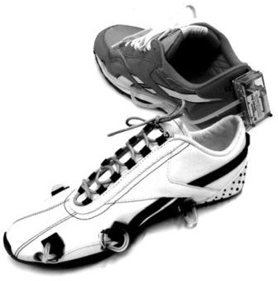
Literature Review
2. A Wireless Human Motion Monitoring System for Smart Rehabilitation:
The paper introduces a new analysis method that utilizes fuzzy logic to continuously and smoothly detect gait phases, enabling a comprehensive utilization of GCF sensor information.
Additionally, the paper presents a higher-level algorithm that quantitatively monitors abnormalities in human gait, including improper GCF patterns and incorrect gait phase sequences.
The proposed methods are implemented using sensor-embedded shoes, referred to as smart shoes, which feature four GCF sensors installed between the cushion pad and the sole.
Overall, the research paper introduces an approach to gait monitoring using air pressure sensors and provides insights into the detection of gait phases and abnormalities, offering potential applications in advanced rehabilitation systems.
[3]
[3] Kong, Kyoungchul, and Masayoshi Tomizuka. "A gait monitoring system based on air pressure sensors embedded in a shoe." IEEE/ASME Transactions on mechatronics 14.3 (2009): 358-370.

Slide 5
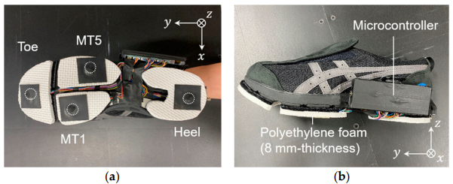
Literature Review
3. This work develops a shoe sole sensor system with high-capacity, compact triaxial force sensors to estimate three-directional ground reaction forces (GRFs) during walking and turning movements. By utilizing Cr–N strain-sensitive thin films mounted at key points on the shoe sole, the system captures detailed GRF data, which is then processed using machine learning models, including multiple linear regression (MLR) and Gaussian process regression (GPR). The results demonstrate that the GPR model effectively predicts GRFs in the y and z directions with a prediction error of less than 15%, showing strong agreement with force plate measurements
[3]
[5] Prediction of Three-Directional Ground Reaction Forces during Walking Using a Shoe Sole Sensor System and Machine Learning

Slide 6
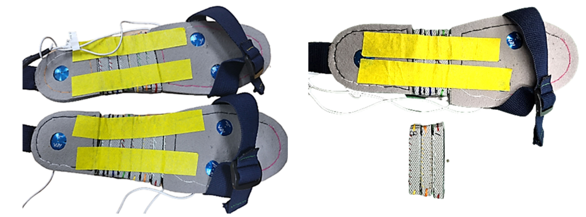
Literature Review
3. This paper presents a method for estimating three-axis ground reaction forces (GRFs) during walking using shoes equipped with three uniaxial EzForce-1D optical load cells and a sequence-to-sequence Long Short-Term Memory(seq2seq LSTM) model. The load cells, placed on the 1st metatarsal, 5th metatarsal, and mid-heel regions, were designed to minimize distortion and adapt to different foot sizes. The collected data was used to predict vertical, anterior-posterior (AP), and medial-lateral (ML) GRFs. The experiment involved 81 healthy adults walking at their preferred speed, with GRF measured using force plates as a reference. The LSTM model was trained with resampled and filtered data from 109 sets and validated with separate test sets.
[3]
[6] A Deep Learning Model for 3D Ground Reaction Force Estimation Using Shoes with Three Uniaxial Load Cells

Slide 7
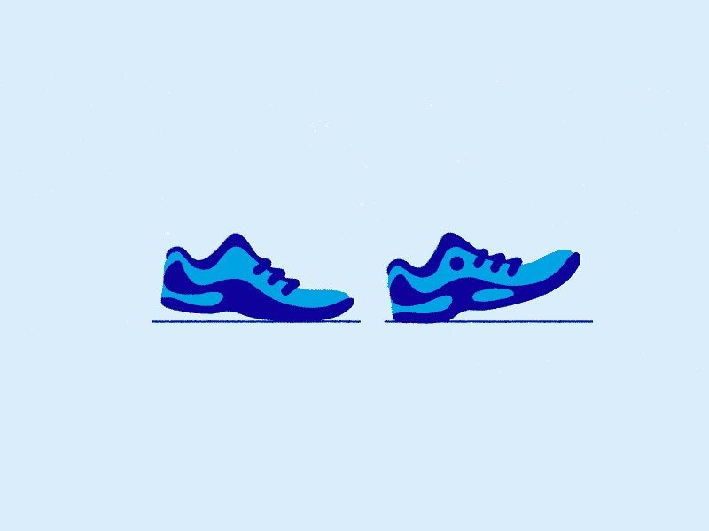
Motivation
Smooth and Continuous Gait activity & GRF detection
Pressure map with individual raw sensor readings: Heat Map for Loading and Force distribution
Wireless & Portable Analysis:
Convenient for End User to monitor daily life activities
Exploring and Leveraging ML techniques in predicting real time GRF
Inexpensive alternative for existing technologies
Various uses in Rehabilitative and assistive research
Indian Institute of Technology Gandhinagar

Slide 8

Objective
The objective of this study is to demonstrate the development and application of a wireless and portable system to predict real-time Ground Reaction Forces through machine learning techniques while providing an inexpensive alternative for existing technologies, and exploring its potential in rehabilitative and assistive research.
Indian Institute of Technology Gandhinagar

Slide 9
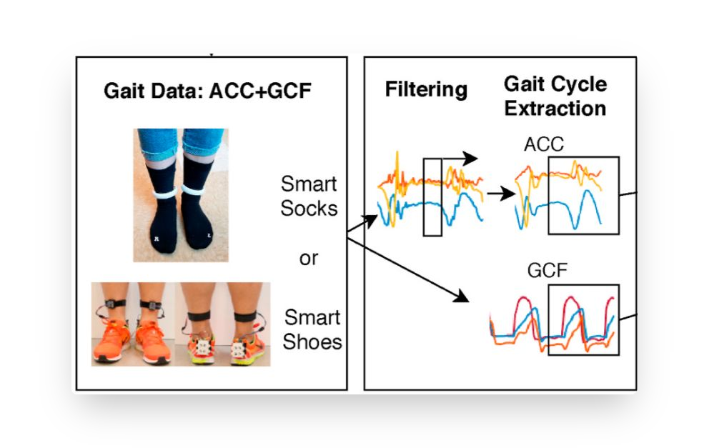
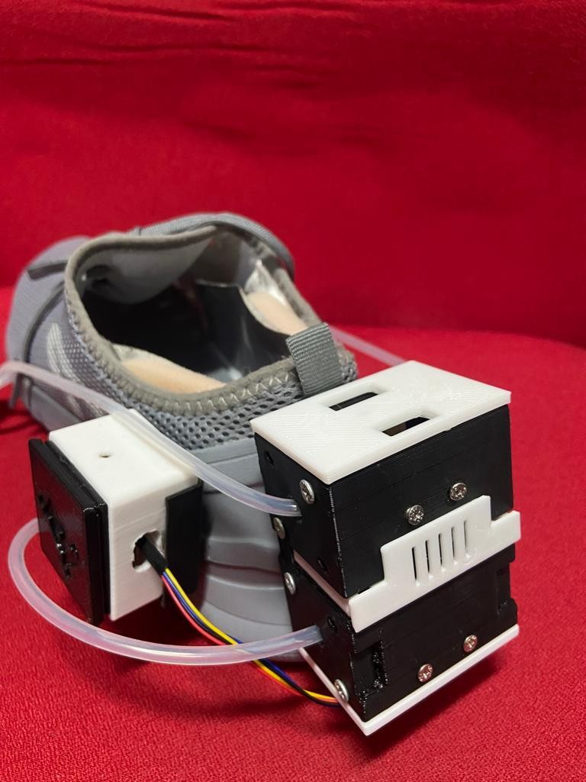
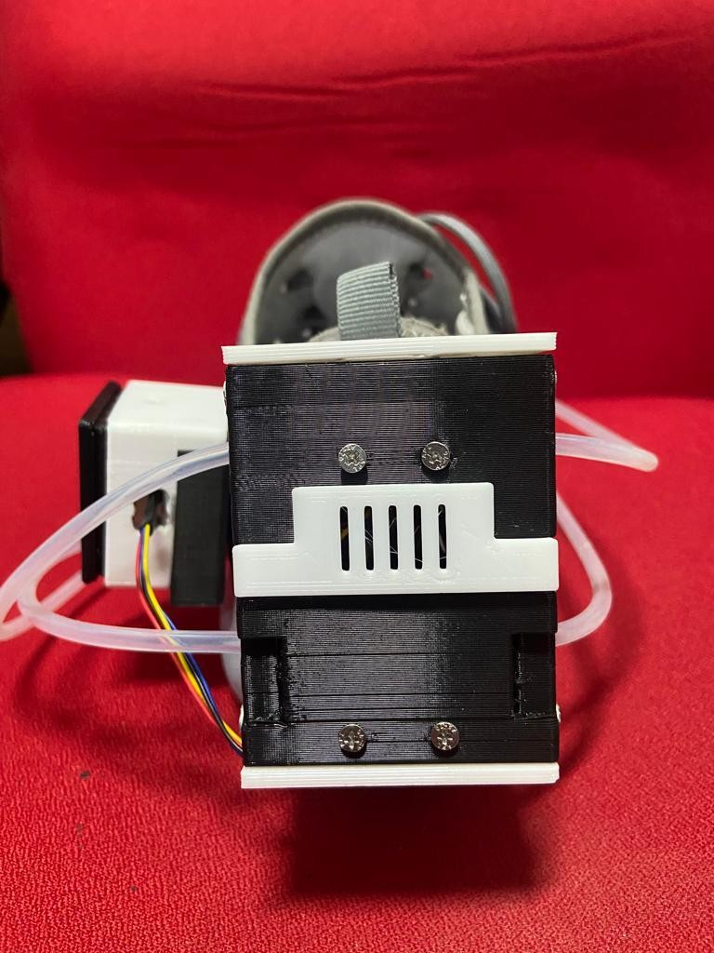
Project Phases
Experiment to obtain Raw Data & Ground Truth
Sensor Fusion & Data Synching
Feature Engg.
/Calibration
Model Real Time
Training Deployment
Indian Institute of Technology Gandhinagar

Slide 10
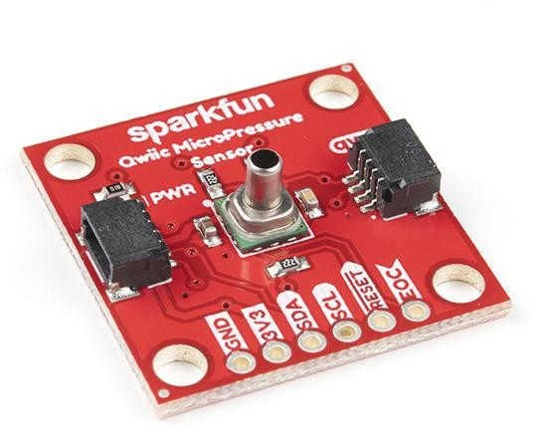
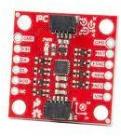
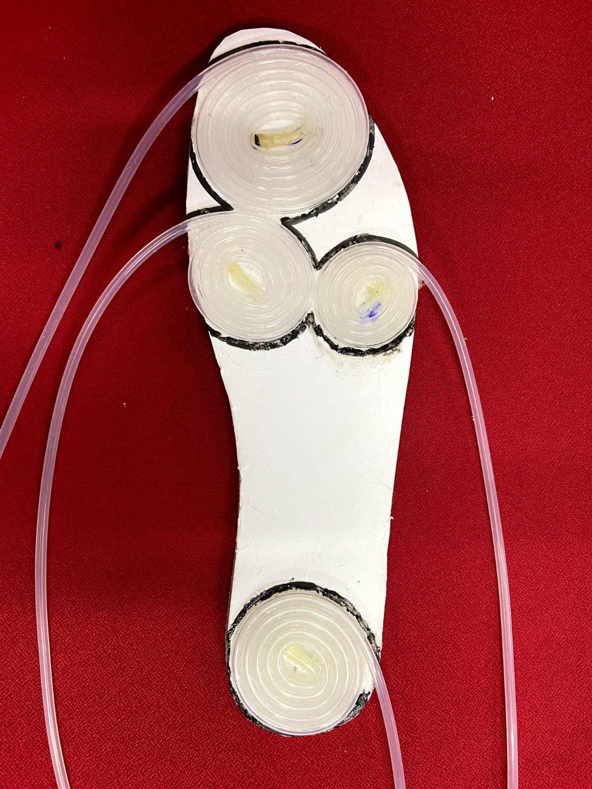
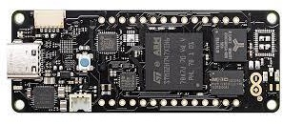
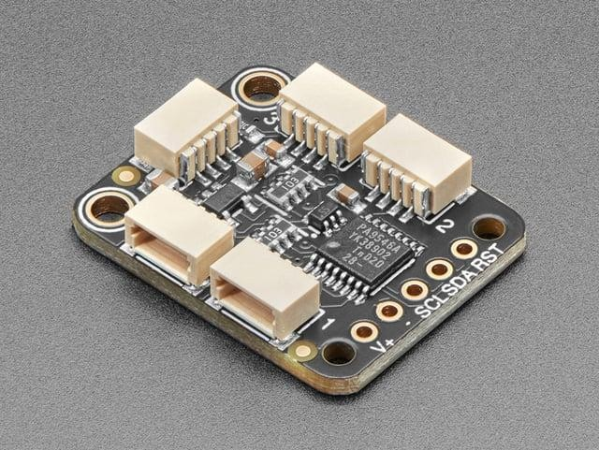
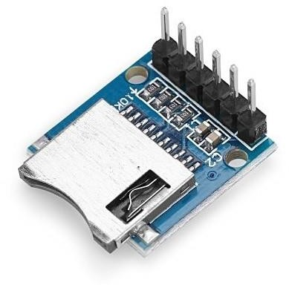
Sensors & Materials
[i]
[ii]
SparkFun Qwiic MicroPressure Sensor
Portenta h7
Sparkfun ICM-20948 9-dof IMU
[iii]
[iv]
[4]
Adafruit PCA9546
4-Channel Multiplexer
3.3V Micro SD module
[4] Shoe Insole with Silicone tube coiled pressure pads placed at: [i] Toe [ii] Metatarsophalengeal 1-2 [iii] Metatarsophalengeal 3-4 [iv] Heel

Slide 11
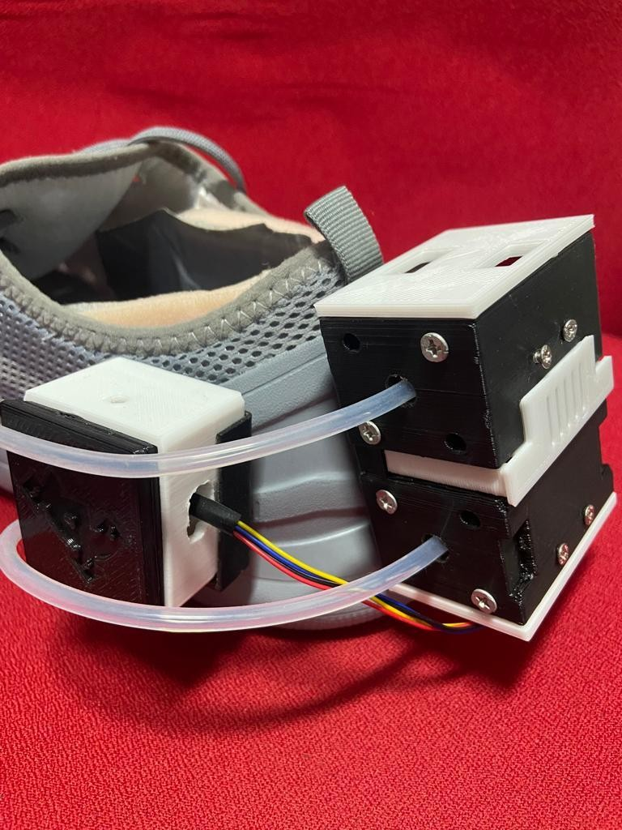
Experimental Design
Smart Shoe designed with 3D printed housing sensors to predict real time GRF

Slide 12
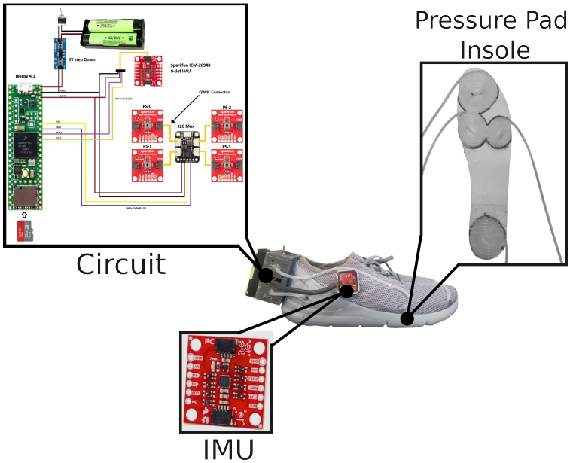
Experimental Design
Smart Shoe designed with 3D printed housing sensors to predict real time GRF

Slide 13
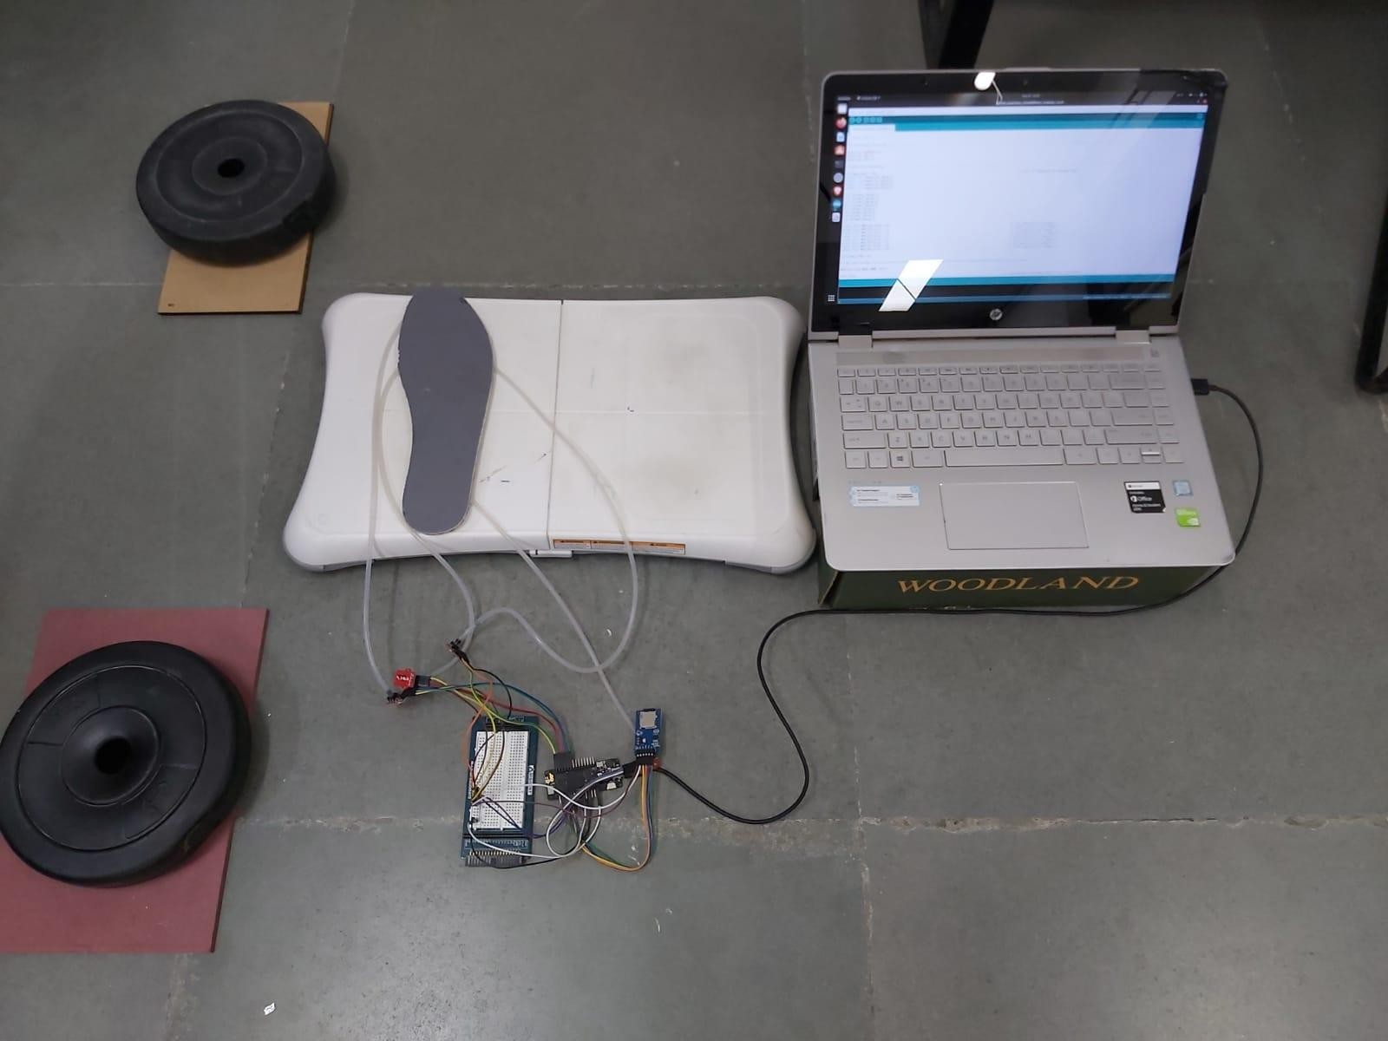

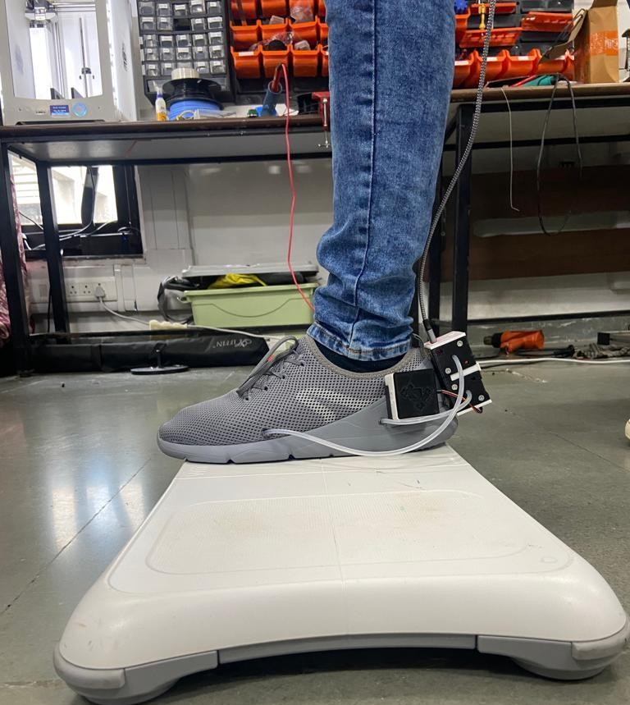
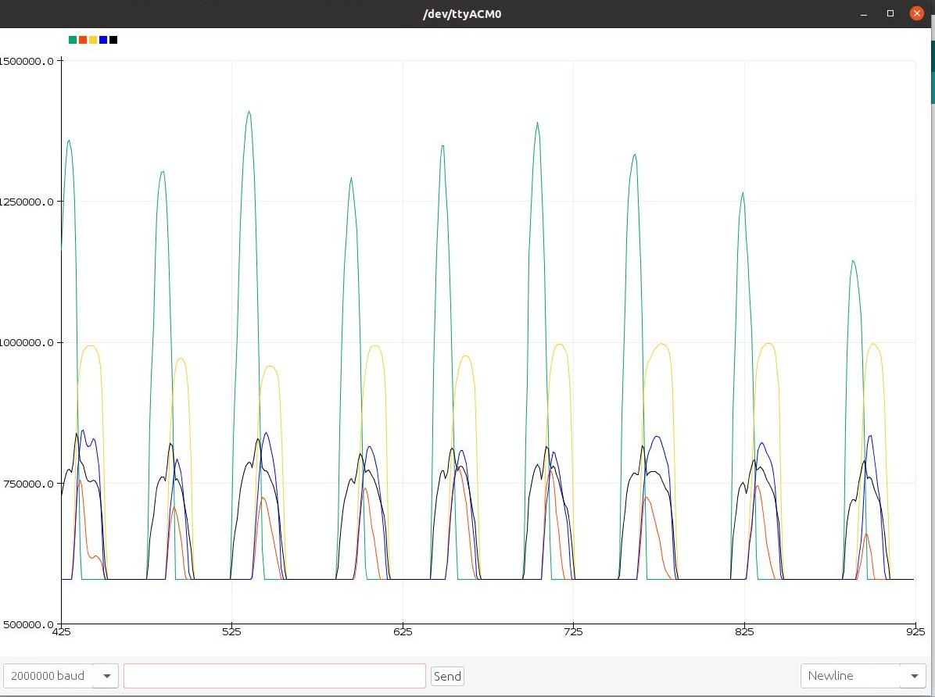
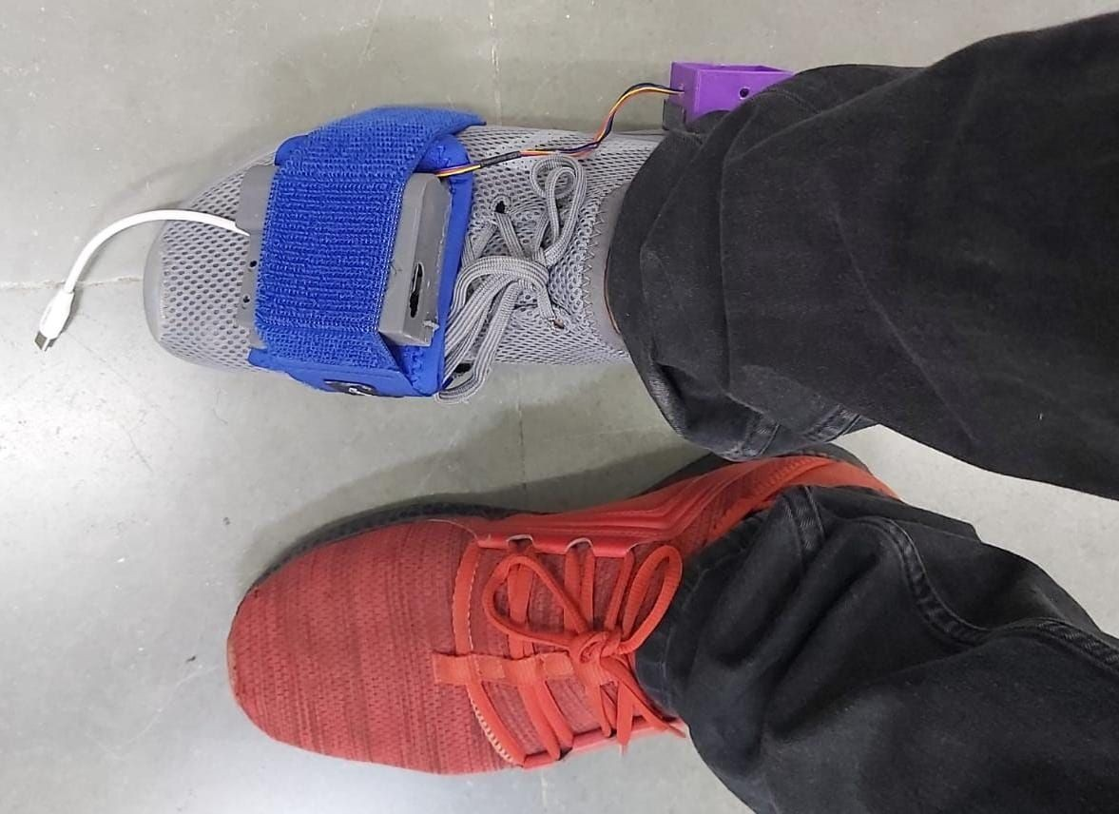
Data Collection
Before
Now
Indian Institute of Technology Gandhinagar

Slide 14
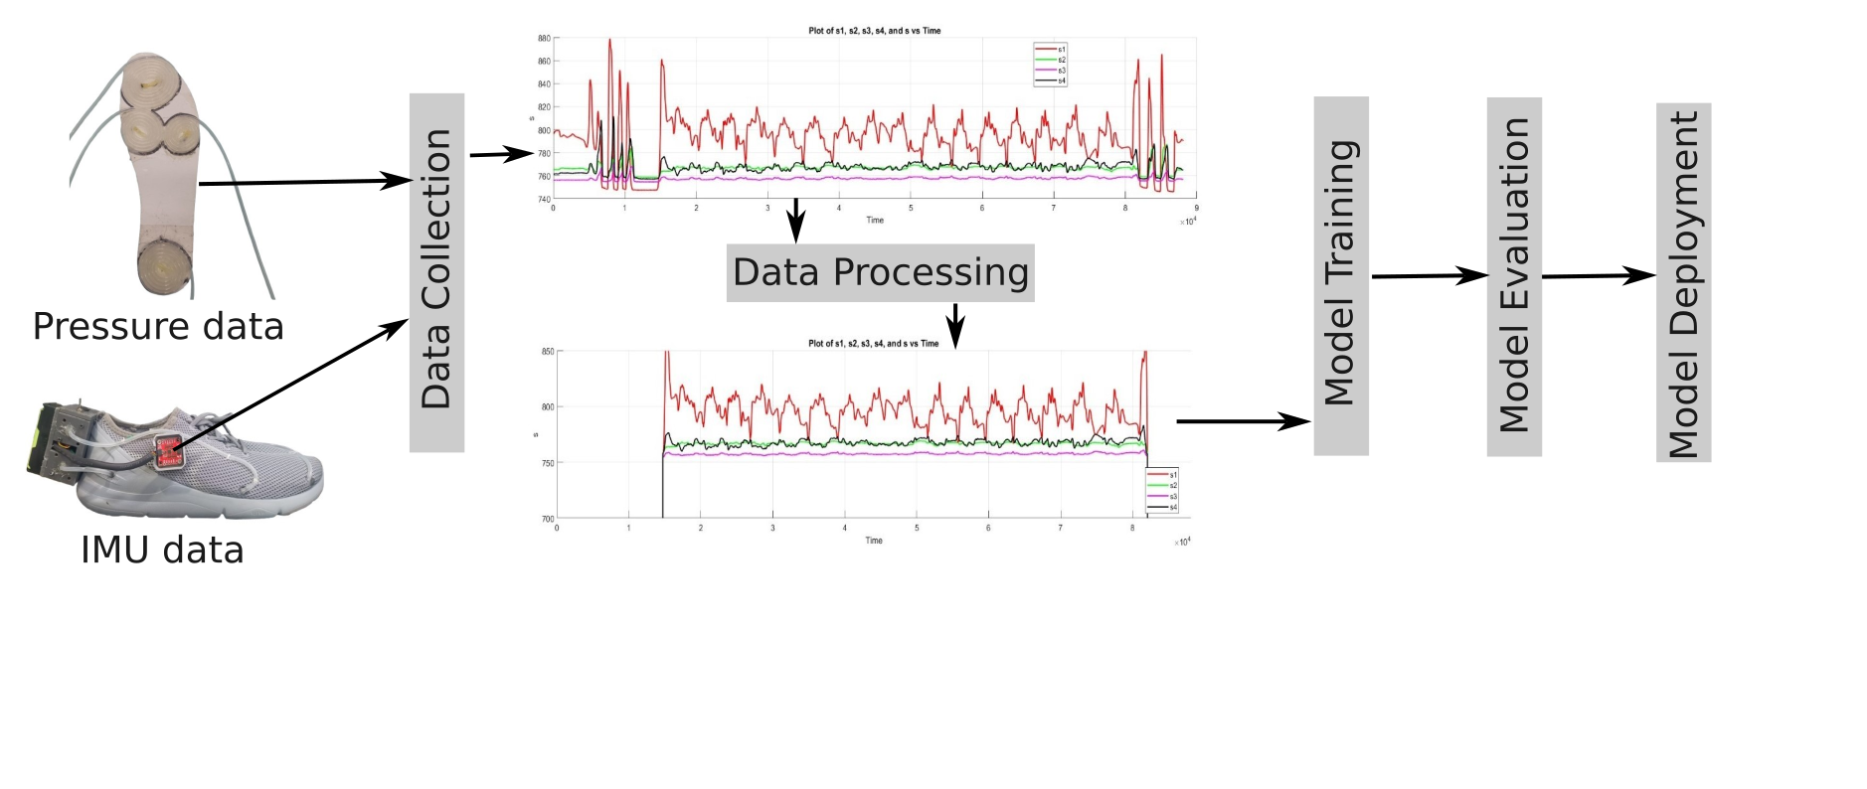
Data Collection
Indian Institute of Technology Gandhinagar

Slide 15
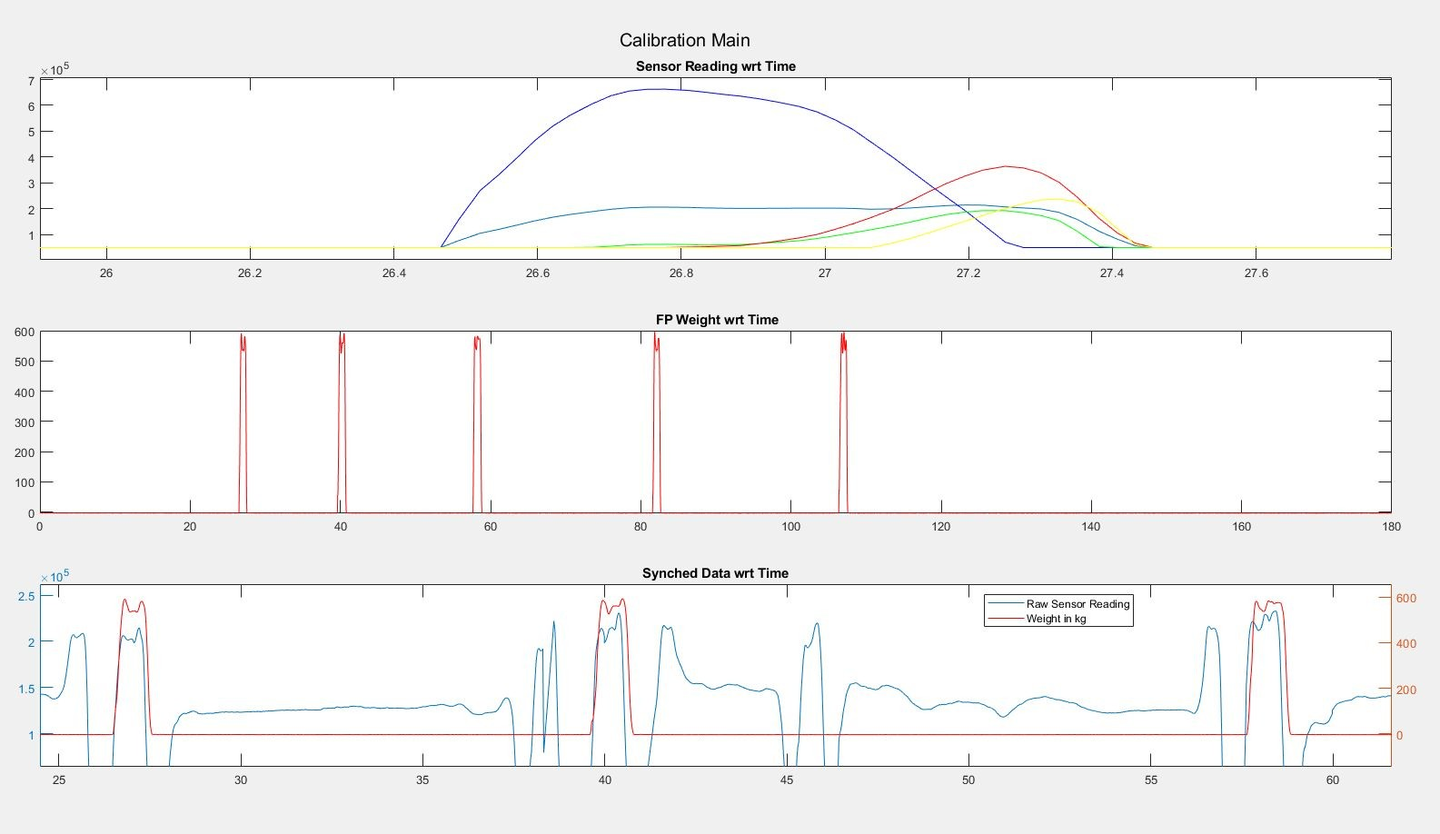
Data Synching & Calibration
Force Profiles
Force Plates
Smart Shoe
Similar Force Profiles obtained from Developed Smart Shoe and Force Plates

Slide 16
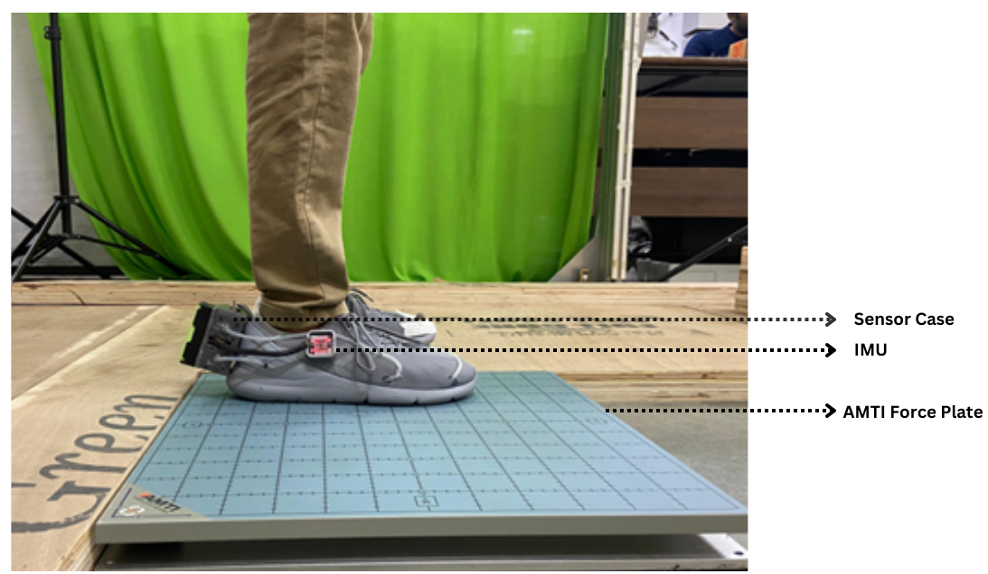

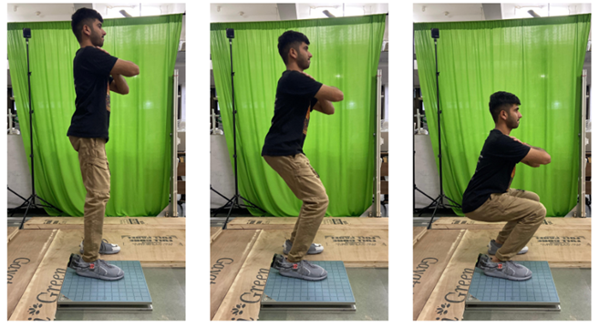
Data Collection
4 Subject Data Collected
3 bouts / speed
3 Different
trial
Experiments
Squatting Experiment
Indian Institute of Technology Gandhinagar

Slide 17
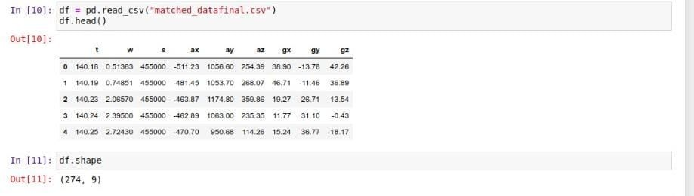
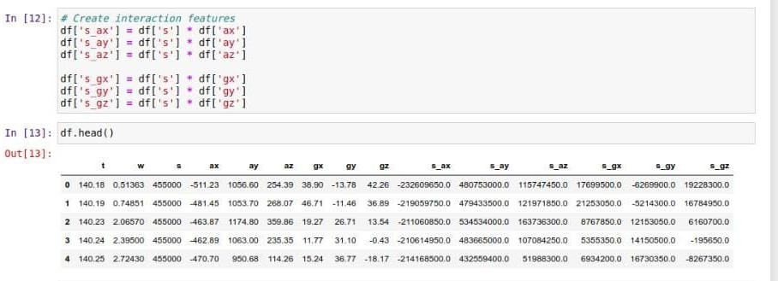
Data Visualization & Processing
Experiment Data Extraction from MATLAB
Importing Libraries, Loading Feature DataFrame
Normalizing Data and Creating Interaction Features
Indian Institute of Technology Gandhinagar

Slide 18
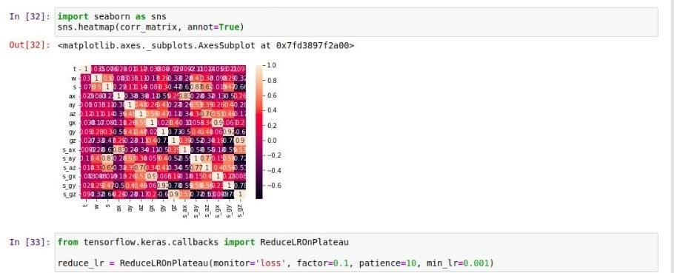
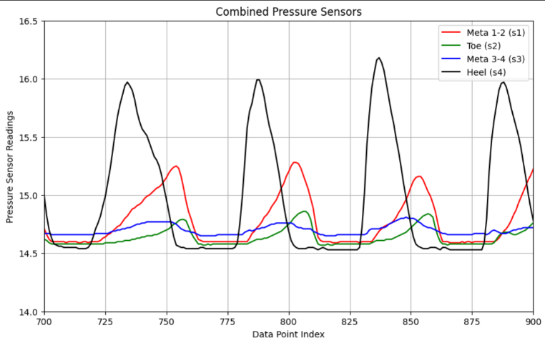
Visualizing Data, Outliers,
Distribution, Correlation Matrix
Splitting Data for Training and Testing
Model Training
Pressures sensor values during gait cycle
Indian Institute of Technology Gandhinagar

Slide 19
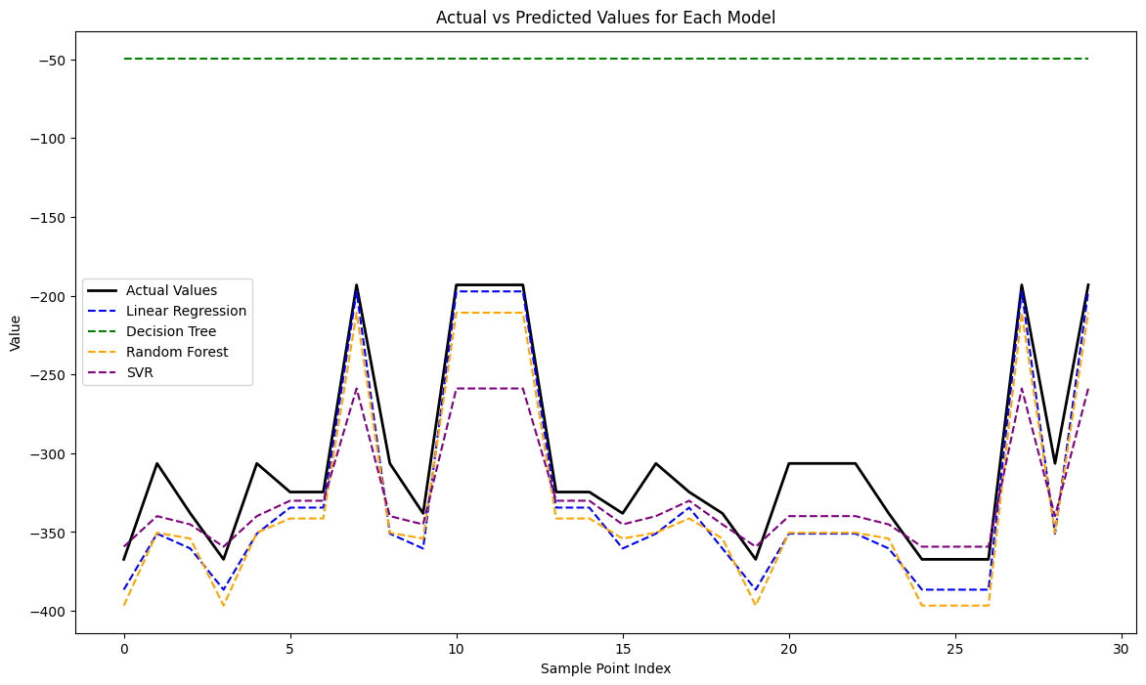
Model Training
Regression Techniques
Models Used:
Linear Regression (Baseline) (30%)
Decision Tree Regression (32%)
Random Forest Regression(38%)
Support Vector Regressor (SVR)(62%)
Regression MSE’s
Indian Institute of Technology Gandhinagar

Slide 20
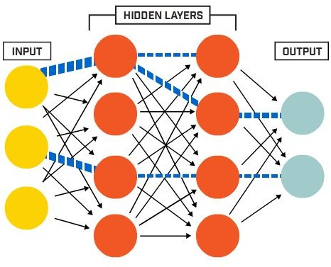
Model Training
Why Deep Learning?
Multiple Layers/hidden layers that distills some of the important patterns from the inputs and passes it onto the next layer
The activation function serves to capture non-linear relationship between the inputs, therefore it has the ability to learn and model non-linear and complex relationships
We started with a simple 2 layered network for baseline model, which itself gave 70 % accuracy and outperformed regression techniques.
Later by increasing the number of neurons and layers, also by adding Batch normalization , we have achieved accuracy of 93 %.
Indian Institute of Technology Gandhinagar

Slide 21
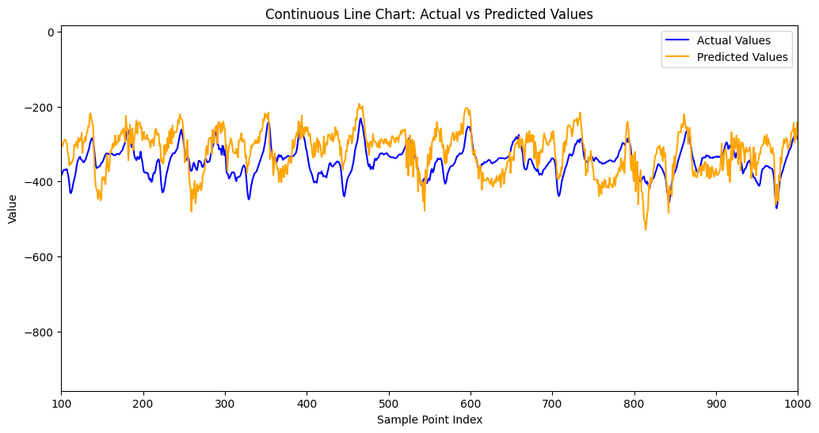
Deep Learning Output
Fresh subject squatting data
Indian Institute of Technology Gandhinagar

Slide 22

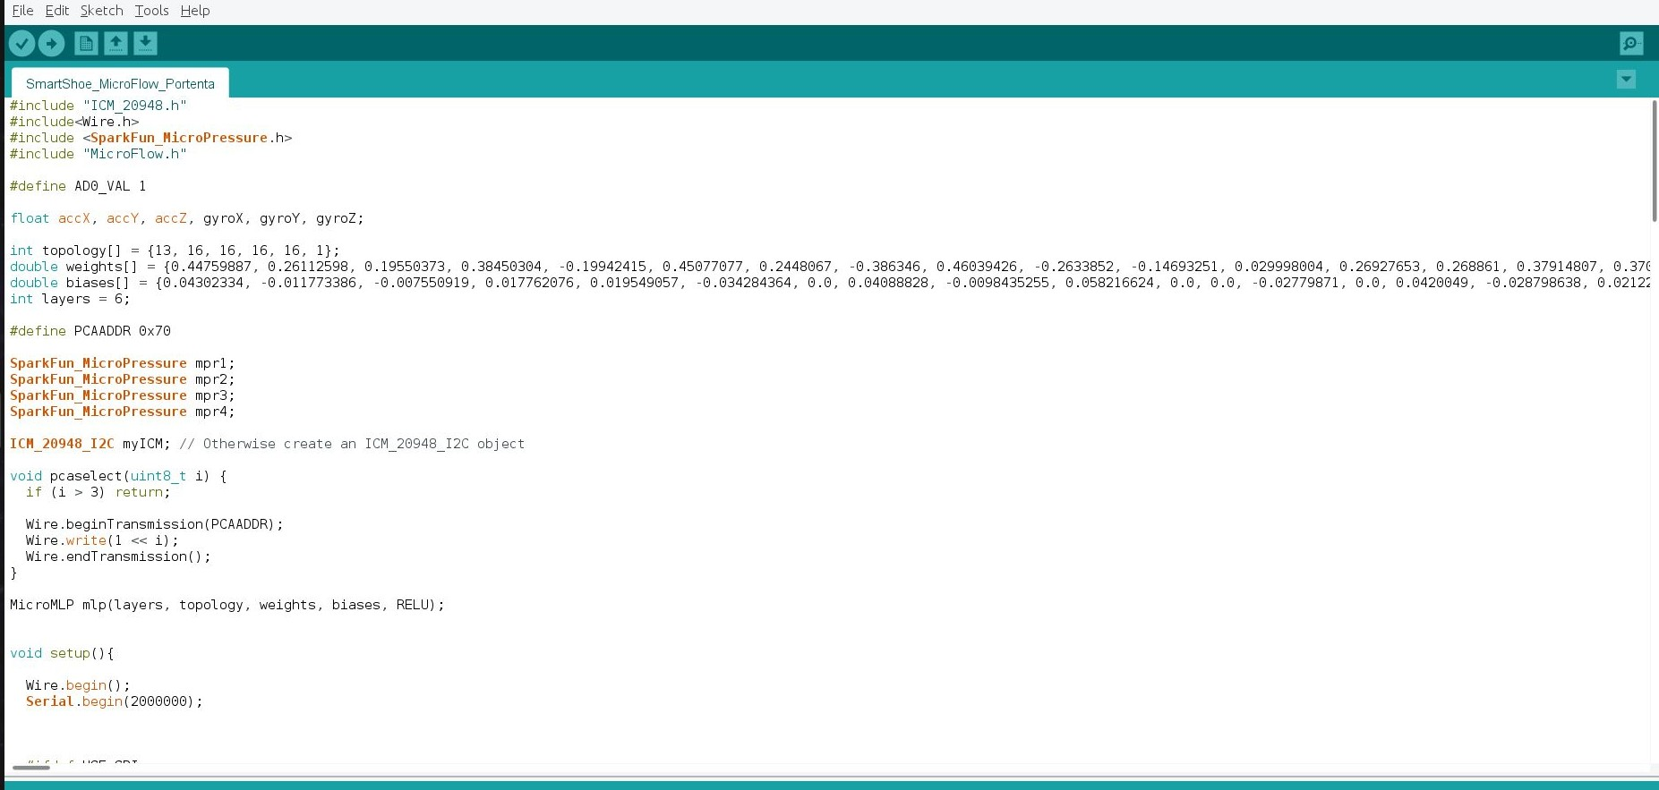
Model Deployment
MicroFlow
Quantized
Weights & Biases
Inference for Onboard Computation
Indian Institute of Technology Gandhinagar

